Slide 1

ResumeEnhancer - AI-Powered Resume Optimization
Evan Wall, Thay Chansy, & Omid Khan

Slide 2

Elevate Your Data Career with ResumeEnhancement App!

Slide 3
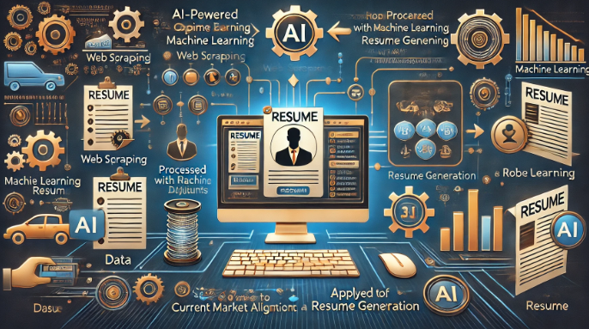
Project Overview
Overview:
AI-powered system to optimize resumes based on current job market demands.
Focus areas:
Web scraping
Machine learning
Resume generation
End goal: Help job seekers enhance resumes for better market alignment.
Evan

Slide 4
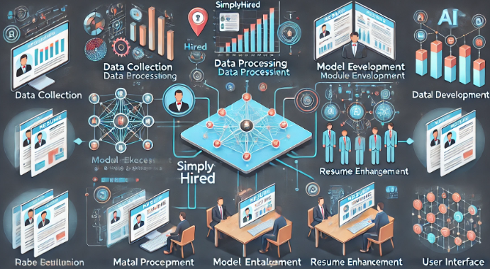
Key Objectives
Data Collection: Scrape job postings from SimplyHired.
Data Processing: Analyze key skills and trends.
Model Development: Train ML models on job descriptions.
Resume Enhancement: Generate optimized resumes.
User Interface: Build an easy-to-use platform for users.
Evan

Slide 5
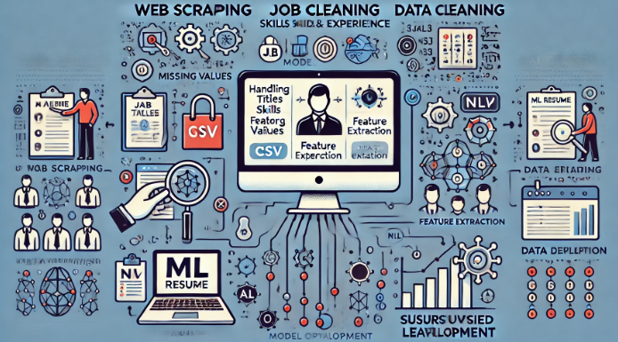
Key Tasks and Procedure
Web Scraping:
Collect data (job titles, skills, experience).
Store results in CSV files for analysis.
Data Cleaning:
Handle missing values, extract key features.
ML Model Development:
Use NLP for pattern recognition and text classification.
Supervised and unsupervised learning techniques.
Evan

Slide 6
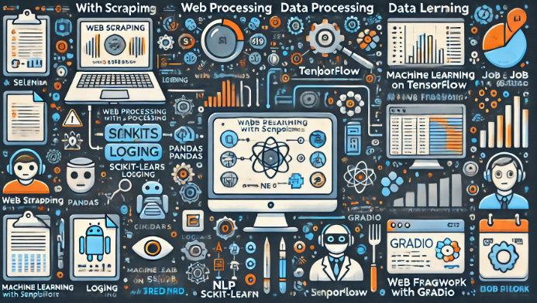
Tools and Technologies
Technologies:
Web Scraping: Selenium
Data Processing: Pandas
Machine Learning: Scikit-learn, TensorFlow
NLP: BERT NER
Web Framework: Gradio
Data:
1,000+ job postings from SimplyHired
Job titles, skills, experience levels, job descriptions
OmOmid

Slide 7
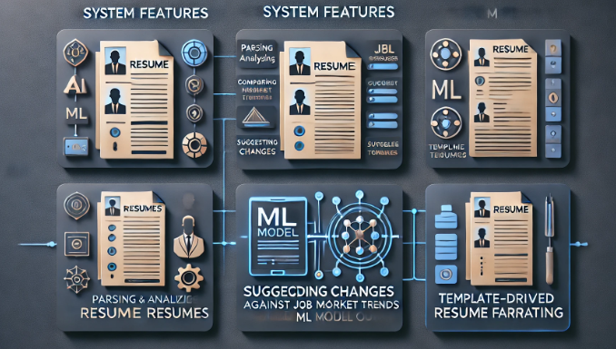
Resume Enhancement System
System Features:
Parse and analyze input resumes.
Compare resumes against job market trends.
Suggest changes and enhancements based on ML model outputs.
Template-driven resume formatting.
OmOmid

Slide 8
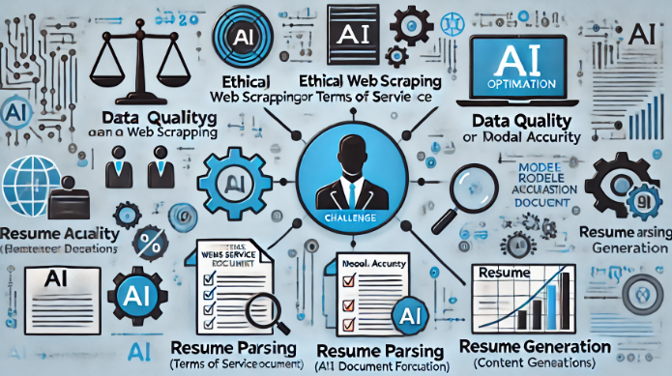
Challenges
Model Accuracy: Capturing nuances across industries.
Resume Parsing: Handling diverse formats.
Content Generation: Generating natural-sounding resume text.
OmOmid

Slide 9
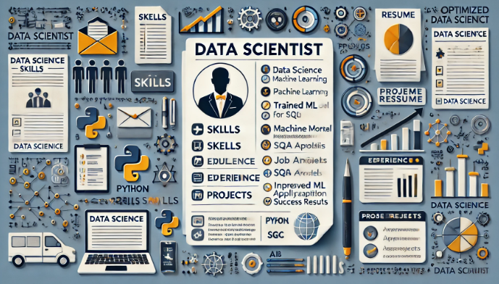
Expected Outcomes
Functional web scraper for job data collection.
Trained ML model analyzing job requirements.
Resume enhancement system providing tailored suggestions.
Deploy via Hugging Face w/ user-friendly interface for job seekers.
Improved job application success rates for users.
Thay

Slide 10

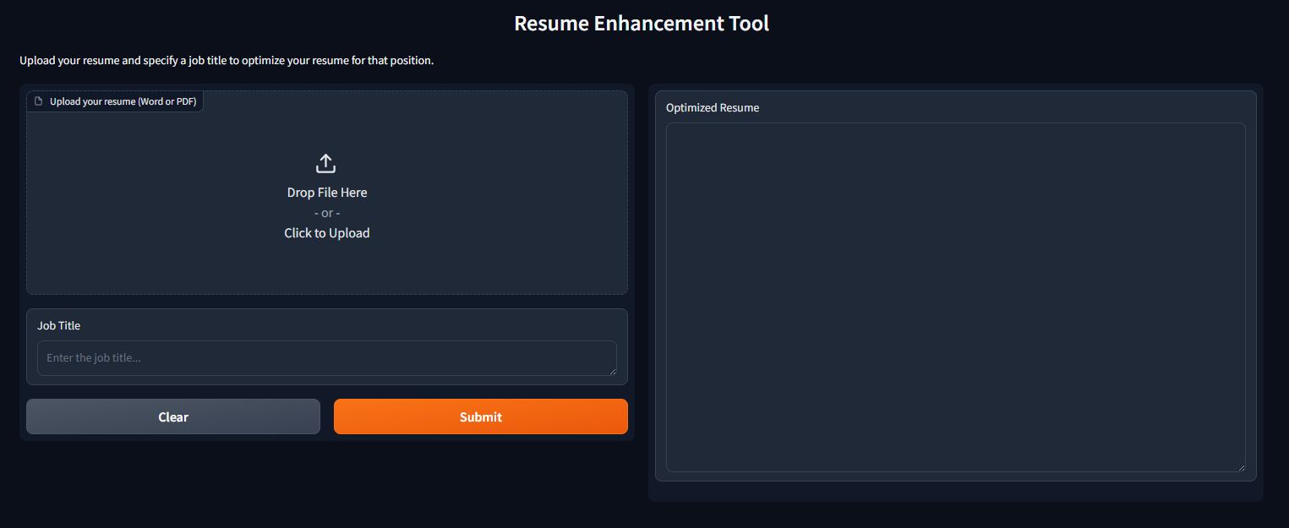
Web App Live Demo
Thay

Slide 11
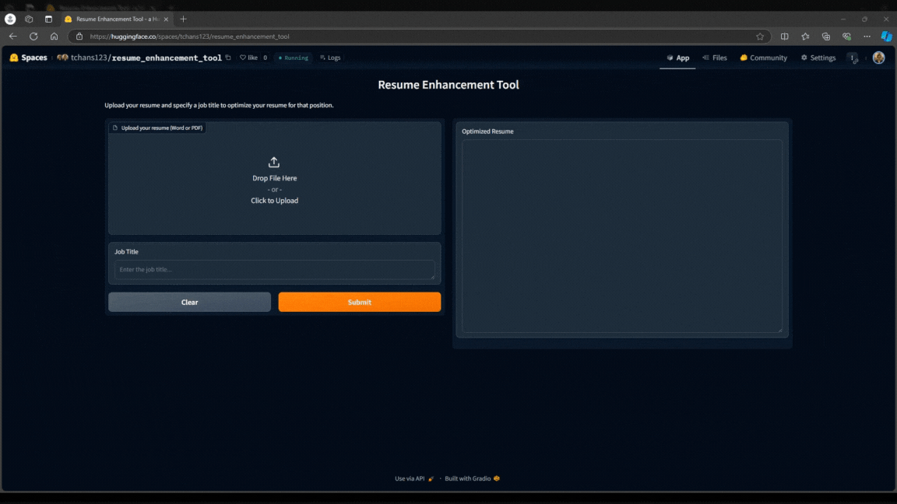
Upload Resume and
Specify a Job Title to Optimize
Thay

Slide 12

Questions?

